Slide 1



Club President’s Companion
Welcome to your presidency:
9 points that will make your job easy!

Slide 2
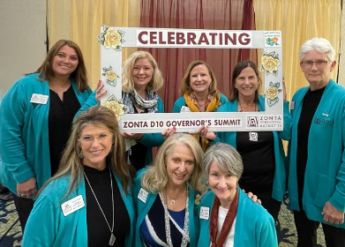
1. Two immediate sources for help:
Source #1:
Your district area director

Slide 3
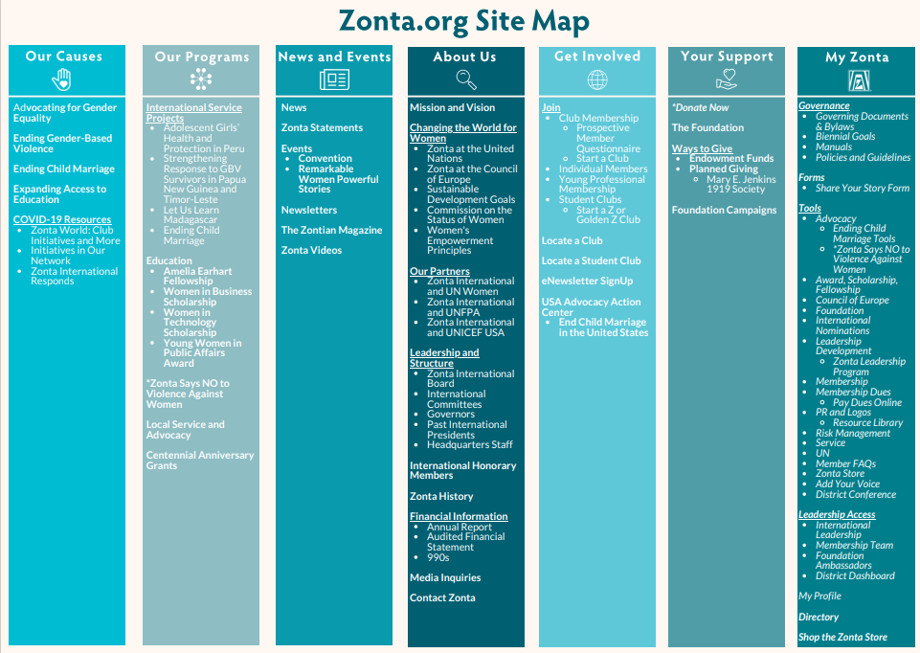
Source
#2: Tools

Slide 4



1. Engage and motivate the members to participate in the clubs’ work
Using their knowledge, experiences and interest
2. OBSERVE:
See, Listen and Pay attention
Members appreciate when leaders are aware of their contributions, time, work and donations.
2. Your role -- the 5 most important tasks

Slide 5



3. Lead the club
Create conditions to meet goals
Goals should align with Biennium Goals
4. Create an effective board
All members need to feel involve
5. Involve your colleagues from the start-
Collaborate and have FUN!

Slide 6

3. The Role of your Board
The primary role of the club board is to recommend advocacy actions, service projects, and donations and make suggestions for policies for adoption by the club.
Notes:
When in doubt, verify alignment to the mission

Slide 7


4. Club Committees
Involve the club members in actions that empower women, each club should have task forces/committees as appropriate for smooth operations.

Slide 8


5. Financial Management
Fiduciary Responsibility.
Work closely with the club treasurer.
Confirm :
Paying bills and taxes
Collect Dues
Become familiar with Zonta’s policies and procedures on club finances.
For USA clubs there are two options for filing taxes, either under the Zonta International umbrella or directly to the IRS.

Slide 9
6. Getting Organized
Prepare club meeting agendas:
Allow enough time for Zonta issues, news and information from Zonta International.
Include members to give reports on international projects/programs and events at the UN.
Involve/delegate club members in the club performance
Ensure the board members get all relevant information in time which allows them to come well prepared and make the meeting more efficient
Notes:
ust because “it’s always been done that way” does not mean it cannot be changed. Consult with your board and other club members to consider e.g. type of meeting agenda, method of reporting minutes, plan for membership recruitment and retention, plan for fundraising, etc

Slide 10
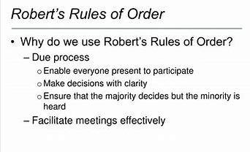
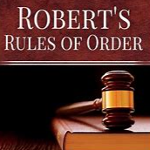
7. Parliamentary Procedures
Zonta is a democratic organization.
All members in good standing have the right and responsibility to vote on all decisions that impact your club.

Slide 11
Parliamentary rules facilitate healthy discussions and allow every voice to be heard.
Robert’s Rules of Order are generally used in Zonta,
Should the laws and customs in your country prescribe others, that is fine.
Good references for learning how to conduct proper voting can be found in the club manual.

Slide 12
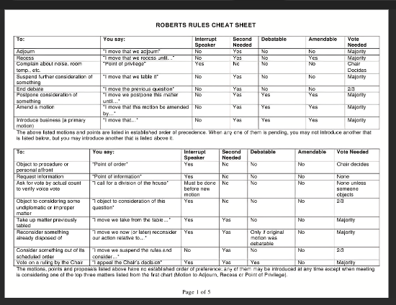

Slide 13
8. Protocol is an Attitude
Observing protocol shows respect and gratitude for our Zontians work.
The Zonta International Protocol Manual shows you the “How to…”
It answers the questions you may have when you invite Zonta members or elected leaders to your club events or meetings.

Slide 14

Protocol Example:
Gifts and Flowers Gifts are not required and generally are being replaced by other forms of appreciation in the name of Zonta, or for the benefit of one of Zonta International's many service projects.
Depending on the culture and custom, a souvenir may be presented to the guest during the visit.
In all cases, a Zonta rose may be a gift.

Slide 15
9. Resources
As president, you are the “go-to” person in your club when questions arise… and it is ok to say, “I will research that and get back to you”
(Refer to Rule #1 and Call an Area Director!)
A few months after convention, you will receive a copy of the new Governing Documents from ZI Headquarters. This is a booklet that contains the International Bylaws, biennial goals, a description of the current international projects and a glossary.

Slide 16
Everything you need to know can be found in the Governing Documents, the Zonta Club Manual and the website.
Visit zonta.org
Manuals, forms, biennial goals, resolutions,
the Zonta Store, and much more makes your work as club president easy, efficient and enjoyable.

