Slide 1
Welcome to the Zonta International District 10 2026 Area Meetings
ADVOCACY

Slide 2
Agenda
Zonta International Strategic Plan for 2023 to 2030
Zonta International 2024-2026 Biennium Advocacy Goals
Four Focus Areas for Advocacy.
Four Shared Moments of Activism.
Four New Initiatives.
USA Caucus Focus Areas 2024-2026
UN and CSW
What Can You Do As an Individual?

Slide 3
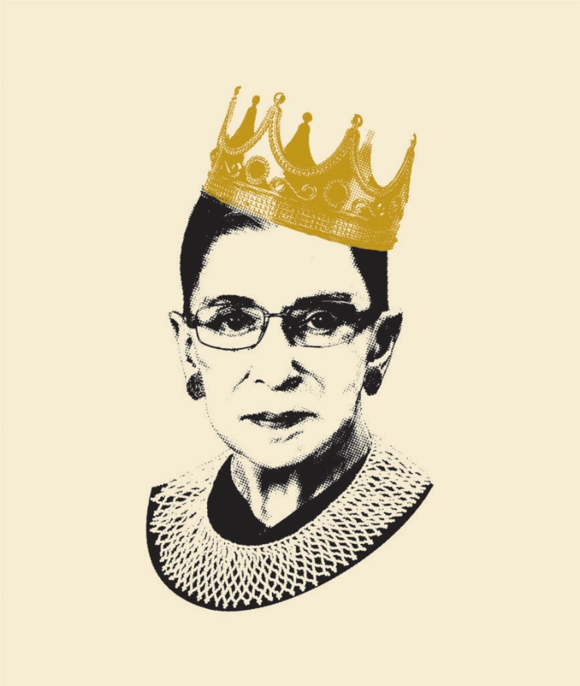
Zonta International Strategic Plan for 2023 to 2030 for advocacy
Greater focus on Advocacy
Women should be represented in decision making positions on an equal basis with men.
Direct time and resources to Public Relations and Communications
Position Zonta as an authority on Gender Equality Issues.
Notes:
7 year plan
“Women belong in all places where decisions are being made” -RBG
While maintaining focus on service, ZI will place greater focus on Advocacy by providing a credible and visible voice ensuring women are represented in decision making positions on an equal basis with men.
ZI will direct time and resources to Public Relations and Communication Strategies to position Zonta as an authority on Gender Equality Issues.

Slide 4
What is Zonta advocacy?
ADVOCACY: the expression of support for, or opposition to, a cause, argument or proposal.
Advocacy may include influencing:
LAWS, LEGISLATION OR ATTITUDES.
Zonta advocacy is an action taken in the public interest or for the greater good with respect to advancing the status of women and girls and their human rights.

Slide 5
Zonta International 2024-2026 Biennium
Four Focus Areas for Advocacy.
Four Shared Moments of Activism.
Four New Initiatives.

Slide 6
Zonta International Four Focus Areas
Eliminating Violence Against Women
Climate Justice
Women in Decision-Making
Education Equality

Slide 7
Eliminating Violence Against Women
The Zonta Says NO to Violence Against Women campaign is a platform throughout the year for Zontians to speak up to promote the human rights of women and girls and end gender-based violence. This campaign is highlighted during the 16 Days of Activism between 25 November and 10 December.

Slide 8
Climate Justice
Zonta Says NOW Link
The Zonta Says NOW to Gender-Equal Climate Action campaign focuses on how climate change is increasing gender inequality. This campaign advocates to end the gender-related consequences of climate change.

Slide 9
Women in Decision-Making
Zonta advocates for women to have a seat at the decision-making tables to ensure that women’s voices are heard on local, national and international issues affecting their lives, livelihoods and the environment.

Slide 10
Education Equality
Zonta advocates for the right of every girl to education. Our work to end child marriage improves access to education for girls. Zonta’s scholarships and awards encourage and expand opportunities for women and girls in aerospace engineering and space sciences, business management and business leadership, STEM fields, and public service.

Slide 11
ZI Four Shared Moments of Activism
International Women’s Day / Zonta Rose Day
Earth Day
International Day of the Girl Child
16 Days of Activism/Zonta Says No

Slide 12
INTERNATIONAL WOMEN’S DAY / ZONTA ROSE DAY
This is the day to promote gender equality and advocate for women in decision-making positions. On this day we emphasize Zonta’s commitments and activity in the United Nations (including the Commission on the Status of Women), the African Union and Council of Europe.

Slide 13

Earth Day
This is the day for actions for climate justice and highlighting the work of Zonta Says NOW.

Slide 14
International Day of the Girl Child
This is the day for emphasizing education equality and the elimination of child marriage.

Slide 15
16 Days of Activism / Zonta Says No
This is the time for focusing on the Zonta Says NO to Violence Against Women campaign.

Slide 16
Zonta International: Four New Initiatives
Zonta Virtual Advocacy Series
Zonta Podcast
Zonta Advocacy Training Program
New Zonta Caucuses and Alliances

Slide 17
Zonta Virtual Advocacy Series
Each quarter, there will be a speaker or speakers on advocacy topics linked to one or more of the Four Focus Areas.

Slide 18
Zonta Podcast
Remarkable Women, Powerful Stories is being rebranded and distributed as a podcast on Spotify. This will enable Zonta and its causes to gain more visibility. The new podcast will concentrate on the Four Focus Areas.
Now available on Spotify!

Slide 19
Zonta Advocacy Training Program
An advocacy training program for Zontians is live on ZI website. This program focuses on the rights of women and girls and how to be a gender equity advocate.

Slide 20
New Zonta Caucuses and Alliances
Already there are caucuses and alliances across districts to make advocacy easier and more effective. Examples are the USA and Canadian caucuses, the German Union, and the newly formed Zonta Australia. Work will be done to explore and form new caucuses and alliances across districts (where such groups do not already exist).

Slide 21
Zonta USA Caucus
Founded in 2018, represent 8000+ USA Zontians
Each district has a representative and an alternate
Each Caucus member is on a Committee
Caucus recommends actions and issues statements—the latter is with unanimous approval of U.S. district governors
Meets monthly except during summer
Notes:
Open to all
Meetings at 4pm central, third Tuesday of the month on Zoom

Slide 22
USA Caucus Focus Areas 2024-2026
Equal Rights Amendment (ERA)
https://www.sign4era.org/
Ending Child Marriage
Violence Against Women (including 16 Days and Zonta Says No)
Climate Change and Gender Equality (Zonta Says NOW)
Notes:
ERA – ABA recently adopted a resolution recognizing the ERA as the 28th amendment to the constitution
Other possible focus areas: Health; Leadership in Education, Work and Government

Slide 23
Zonta – United Nations
Of the 6,469 non-governmental organizations
(NGOs) with consultative status at the United Nations, only 132 have General Consultative Status, the highest status an NGO can have at the UN. Zonta International was granted General Consultative Status in 1969.
As an NGO with General Consultative Status, Zonta International is invited to participate in the annual Commission on the Status of Women (CSW) in New York.

Slide 24
CSW
The CSW is the largest annual gathering on
women’s rights worldwide, and is the principal
global intergovernmental body exclusively dedicated to the promotion of gender equality and the empowerment of women. The CSW is instrumental in promoting women’s rights, documenting the reality of women’s lives throughout the world, and shaping global standards on gender equality and the empowerment of women.

Slide 25
Sustainable Development Goals
The Beijing Declaration and Platform for Action,
adopted at the Fourth World Conference on Women
in 1995 in Beijing, China, by 189 governments, remains the most progressive and widely endorsed blueprint for women’s and girls’ rights worldwide. The Platform guides policies, programs and investment that impact critical areas of our lives, such as: education, health, peace, media, political participation, economic empowerment, and the elimination of violence against women and girls. Addressing these issues is urgent, with just five years left to achieve the Sustainable Development Goals.

Slide 26
We Will Not Go Back!
In a March 2025 speech to the UN, United Nations Secretary-General Antonio Guterres noted that gender equality is “vanishing before our eyes” and women’s rights are being “abused, threatened and violated” around the world. He opined that gender equality won’t be achieved for another 300 years on the current track.

Slide 27
Rollback of Women’s Rights Globally
In February 2025, ZI issue a statement addressing the rollback of women’s rights saying:
Sadly, over the last several years we have witnessed a systematically disturbing rollback of women’s rights globally. These efforts to undermine the rights of women and girls, coupled with the now alarming significant decrease in funding for development aid from the US and several European countries, are both deeply troubling and regressive actions that threaten the fundamental hard-won progress achieved in advancing gender equality, human rights and sustainable goals.

Slide 28
Attack on Sustainable Development Goals
On March 4, 2025 the US voted against and
denounced the resolution that promoted climate
action and gender equality and withdrew from the
Paris Climate Agreement.
Shortly thereafter ZI issued a statement calling for reaffirmed commitment to the SDGs stating that the US withdrawal from its commitment risks reversing decades of hard- won progress and betrays the collective effort to build a just and more peaceful world.

Slide 29
WE CANNOT BE SILENT
Pam Perraud, Zonta Club of Houston member, President
of the US Women’s Caucus and speaker at the March
2025 CSW voiced her concern that the United States (although a founding member of the UN) appears to be retreating from its traditional support of UN ideals and vital UH agencies like WHO, UN Population Fund, UNESCO, the Human Rights Council, UN Women, the Paris Climate Agreement and the SDGs, all of which support women around the world. Pam suggests that this retreat does not serve our country well and will only diminish, not enhance, America’s future role in the world.

Slide 30
WE CANNOT BE SILENT
On a hopeful note, Pam stated that as a result of these backlashes against women’s rights, there was renewed interest by women’s groups to redouble their effort to “pushback against the pushback” by forming more alliances and promises not remain silent.

Slide 31

What Can You Do?
Sign up for Fast Action Fridays—FAF’s—online or
via text by texting ZONTA to 50457
Zonta USA Caucus website--https://zontausa.org/about-zonta/usa-caucus/#
Read the Zonta USA Caucus Advocacy Bulletin which is full of updates and links for action
Mentor a woman or girl; give back
Think about the most influential person in your life and share your story
Remember if you forget to recognize women/family/children as the nucleus, the “cell” falls apart

