Slide 1
Welcome to the Zonta International
District 10 2026 Area Meetings
Lisa M. LeBlanc
Governor Elect
Membership

Slide 2
Let’s talk membership!
Notes:
I know District 10 loves a good competition so let’s start with a guessing game.
I would like each table to come up with the total membership for District 10 and include the Golden Z members on file with ZI. Of course, the table with the closest guess gets a prize! If you are privy to this information, please do not share.
Total membership 469 including 10 Golden Z.

Slide 3
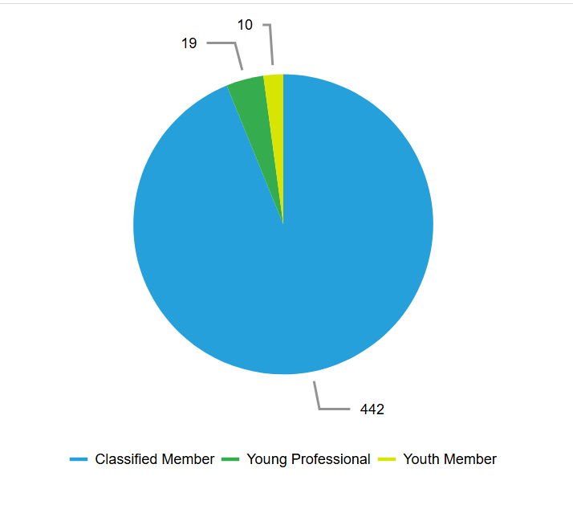
Membership Numbers
Total Membership 434 – July 2025
Total membership 450 - Oct 2025
  433 regular and 17 young professionals
Total membership 471 – March 3, 2026
  442 regular
  19 young professionals
  10 Golden Z (do not count toward voting membership)
Notes:
Congratulations D10 for increasing our membership over the last 5 months!

Slide 4
Large, Mid-Size, and Small-scale
Large – 30 members or more
  Parker County
  Oklahoma
  Houston
  Brownsville
  Seguin
  Fredericksburg
  Dallas
  Lafayette
Mid-Size – 16-29 members
  e-Club USA2
  West Hidalgo
  Fort Smith
  Greater East Texas
  Mineral Wells
Small-scale – 15 members or fewer
  Longview
  Austin
  Shreveport
  Johnson County

Slide 5
Golden Z and Z Clubs
Golden Z
  GET - Kilgore College
  Lafayette – UL Lafayette
  COK – University of Oklahoma
Z Clubs
  Mineral Wells High School
  Longview High School
  Pine Tree High School
  CE Byrd High School
  Captain Shreve High School
  Southwood Senior High
  Huntington High School
  Hallsville High School
  Trinity School of Texas
  Spring Hill ISD
  Carroll Senior High School

Slide 6
Why People Do Not Join Zonta
They do not know Zonta’s impact
No one has asked
The process is too complex
Notes:
What is Zonta’s impact in your community?
The easiest way to gain new members is to ask. Give examples of how you make the ask.
Make the process as simple as possible for potential members. Have a link or simple join form ready. Schedule a member orientation or assign a mentor for new members.

Slide 7
ZI’s Add Your Voice Campaign April – May
Goals:
  Increase Zonta membership through recruitment
  Streamline and use cohesive language in efforts
  Reward expanded recruitment efforts
Four Ways to Participate:
  Activate Your Recruitment Plan
  Refresh Your Information
  Submit for a Recruiting Event Grant | LINK
  Submit for Member to Member Recruitment Recognition
Zonta International Add Your Voice Campaign Toolkit

Slide 8
How to Participate
Activate your Recruitment Plan
  Recruit members April – May
  New members added or joining April and May receive membership through the end of the upcoming year
  As in previous years, the top three winners in each tier will receive recognition from ZI
Refresh your Information
  Update your website and social media
  Audit checklist and templates available on the toolkit
Apply for an Event Grant
  Top three proposals awarded $700 grant for recruiting event

Slide 9
Recruitment event examples
Film Screening
Guest speakers
Volunteer Opportunities
Community Events

