Slide 1
Welcome to the Zonta International District 10 2026 Area Meetings
Governor’s Remarks
Sustainability, Spirit, and
Speaking up for Human Rights

Slide 2
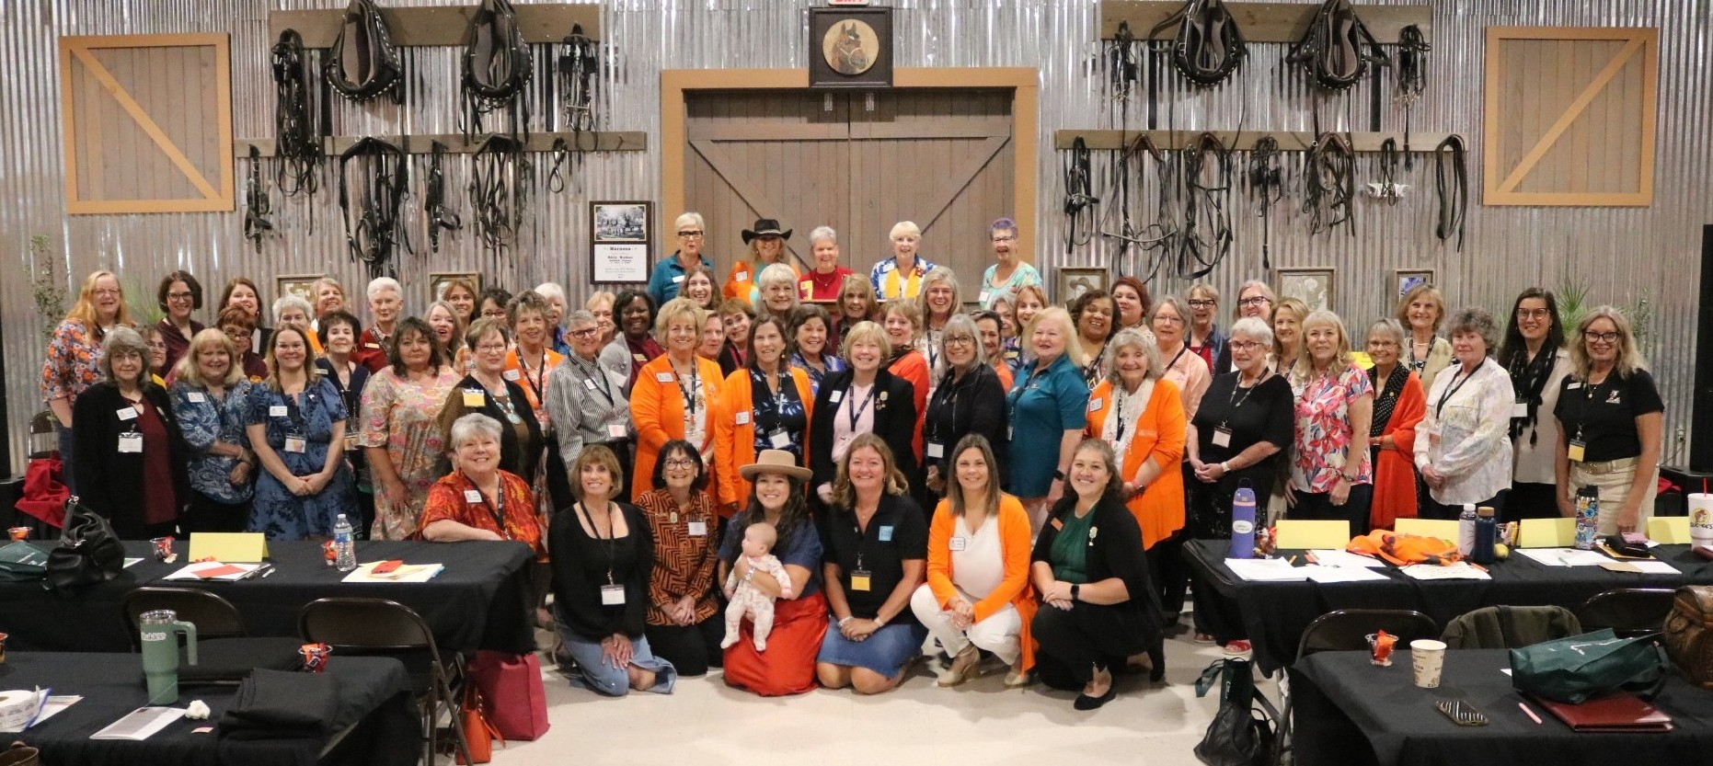
"A woman with a voice is by definition a strong woman. But the search to find that voice can be remarkably difficult."
Melinda French Gates

Slide 3



Celebration
District 10 Club 2026 anniversaries
Area 1
Dallas 102 years
Mineral Wells 71 years
Fort Smith 67 years
Johnson County 45 years
Central Oklahoma 41 years
Parker County 24 years
Area 2
Shreveport 99 years
Longview 71 years
Lafayette 48 years
Houston 38 years* (original charter date 1937; 89 years)
Greater East Texas 19 years
Zonta E-Club USA2 11 years
Area 3
West Hidalgo 79 years
Austin 75 years
Fredericksburg 72 years
Brownsville 67 years
Seguin 53 years

Slide 4
Zonta Accomplishments
District growth
Golden Z Club University of Louisianna Lafayette
Golden Z Club University of Oklahoma
District 10 Conference
Awarded scholarships
Women in Business Award – nomination through Zonta Club of Dallas
Stem Award – nominated through Zonta Club of Fort Smith
Young Woman in Leadership Award – nominated through Zonta Club of Houston
Rose Award – nominated through the Zonta Club of Lafayette
Sara Metcalf Award – nominated through the Zonta Club of Seguin
16 Days of Activism, including the Zonta Says No to Women virtual summit
Zonta advocacy virtual training
Zonta statements
Zonta International responds to U.S. withdrawal from multilateral institutions (2026)
Zonta International Demands Action: End Gender-Based Violence Now - Men Must Speak Up and Stand With Women (Nov. 2025)
Zonta International Statement on including gender perspectives and human rights considerations in UNODC programs (May 2025)
Commission on the Status of Women (CSW) #70 March 9 - 19

Slide 5

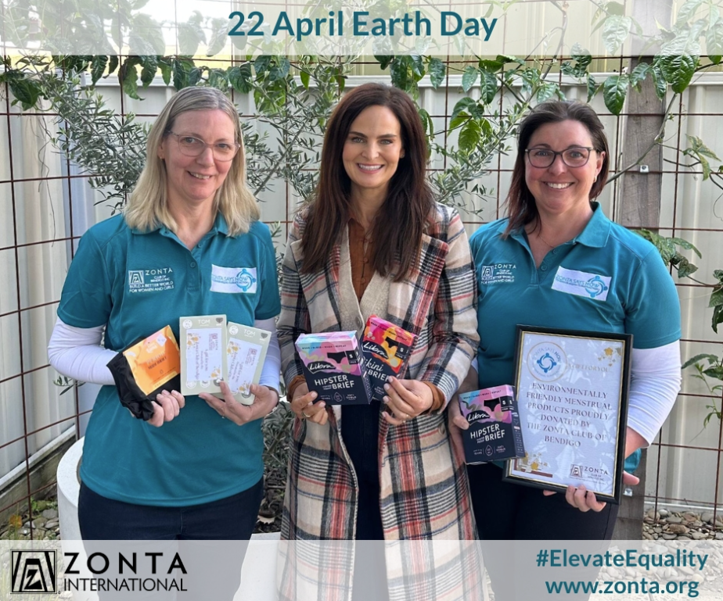
Shared Moments for Zonta Action
8 MAR
22 APRIL
International Women’s Day / Zonta Yellow Rose Campaign
Earth Day

Slide 6
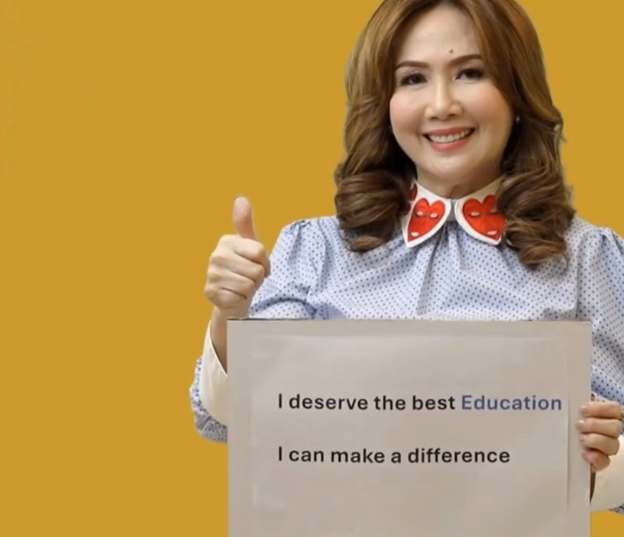

Shared Moments for Zonta Action
11 OCT
25 NOV 10 DEC
In honor of International Day of the Girl
Flip the narrative and send a message of hope
International Day of the Girl
Zonta Says NO to Violence Against Women 16 Days of Activism Campaign

Slide 7
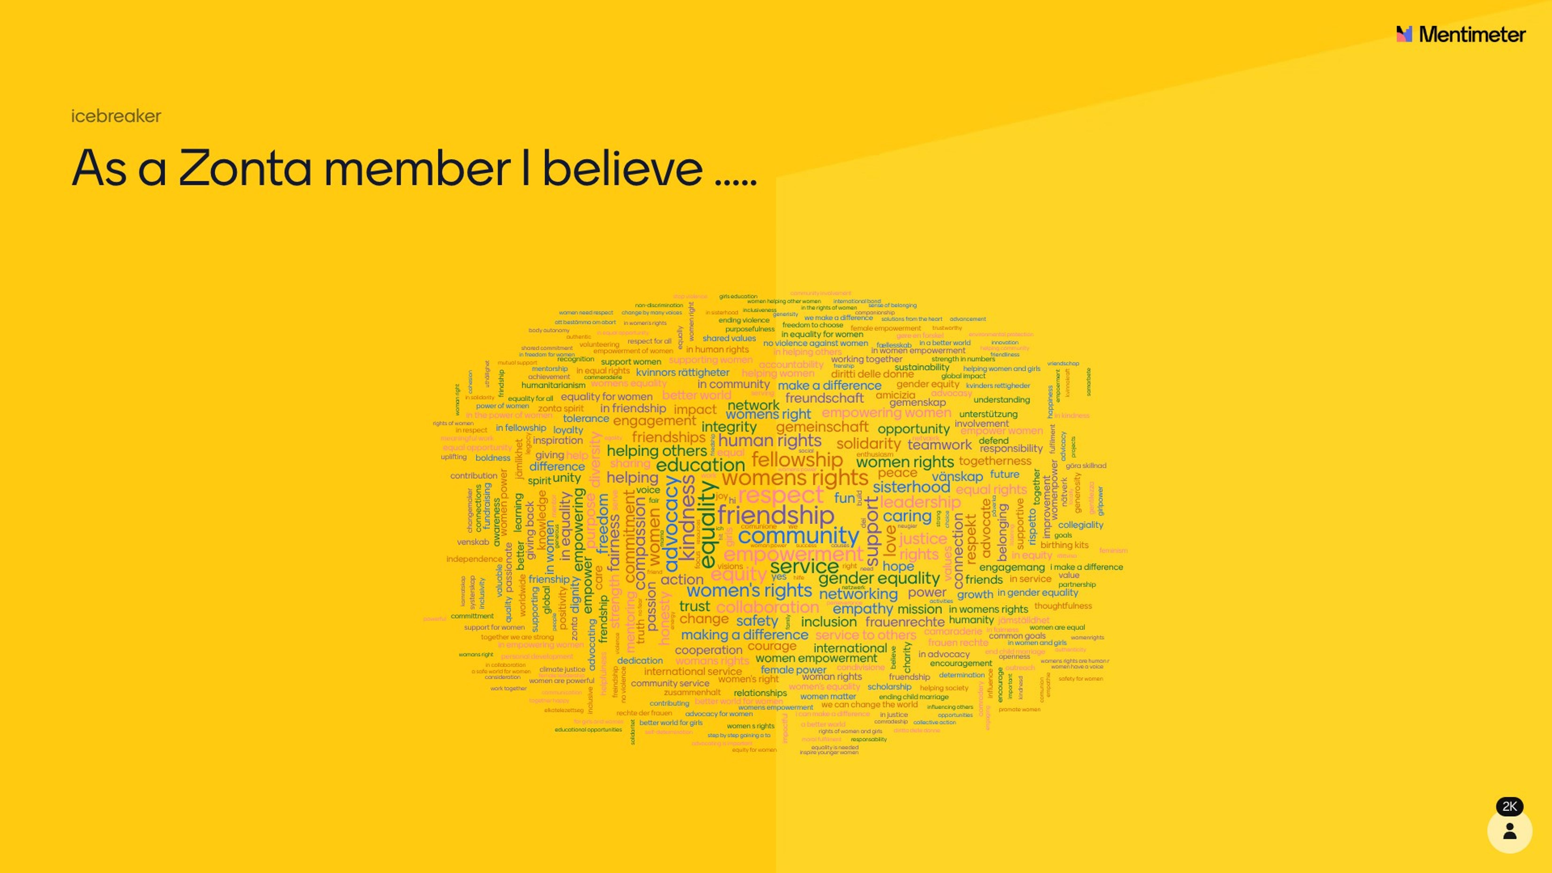
Zonta International Core Values

Slide 8

Zonta International Core Values

Slide 9
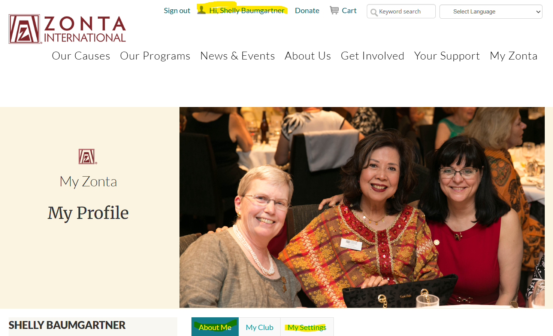
How to change your information at Zonta International
Login to MyZonta at Zonta.com
Or login to the Zonta App and select the person image at the top of the screen
Make changes on the About Me tab and the Settings tab, then Save your changes

Slide 10
Zonta International Convention
2026 Convention elections to be held virtually
Other voting to be held in person
Action | Date / Deadline
Candidate videos published on ZI website | March 31
Credentials deadline for clubs | April 1
Meet the Candidates virtual sessions | Week of April 13
Elections open at 8 am Chicago time | April 27
Elections close at 12 pm Chicago time | May 1
Runoff, if necessary, announced and ballot opens | May 1
Runoff closes 7 am Chicago time | May 4
Election results announced | May 7
Credentials reopen for changes | May 11
Credentials closes for changes | May 25

Slide 11
Zonta International Convention
Vancouver Canada July 11 – 14
What’s App group for District 10
Provide your cell phone # to be included
July 11 – Zonta Says Now Walk/Run 7:30 am
Propose that District 10 meetup for coffee then join the walk together
District 10 will have an official photo time to be announced
Propose that District 10 meetup prior to the Farewell dinner for photos

Slide 12
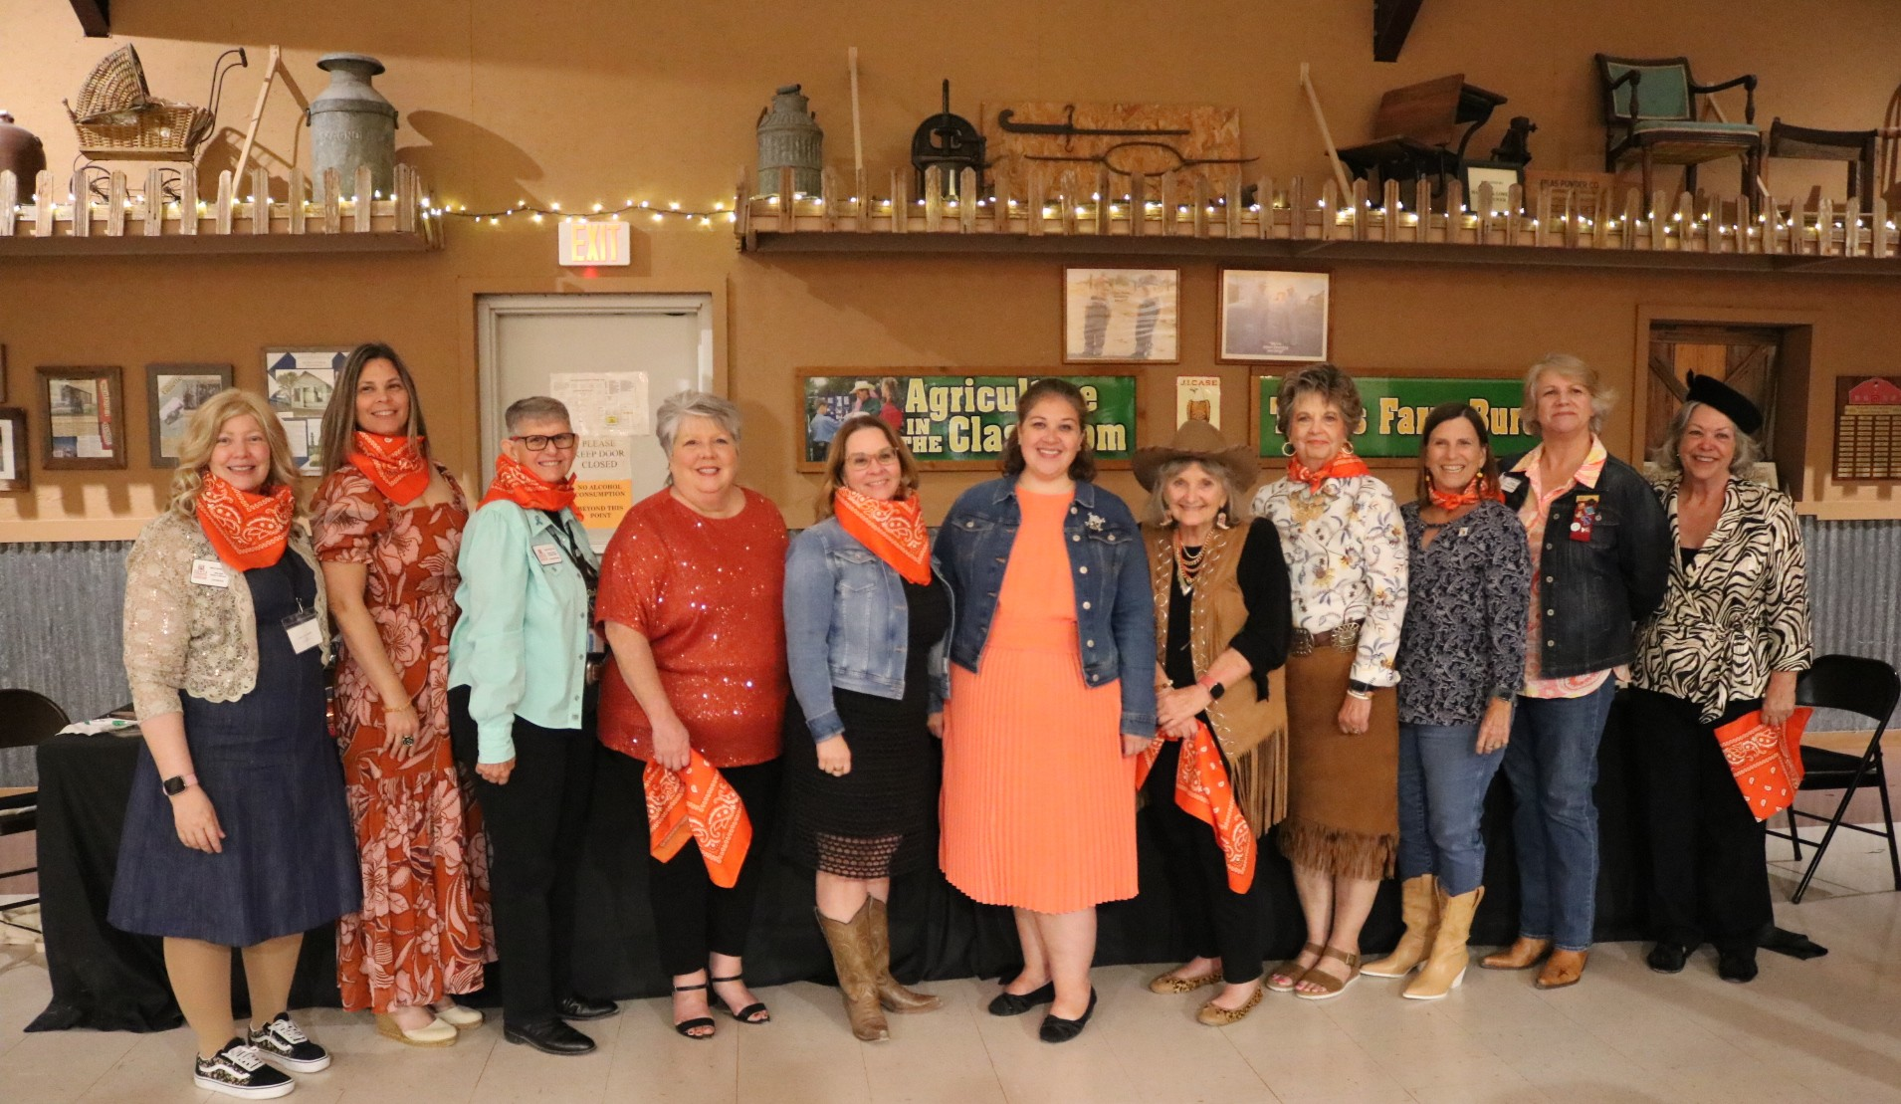
Thank you
The future depends entirely on what each of us does every day; a movement is only people moving.
Gloria Steinem

