Slide 1
Welcome to the Zonta International District 10 2026 Area Meetings
Foundation Report

Slide 2
Foundation Trivia Game

Slide 3
Question 1
Which statement best explains why donations—not dues—are essential to the Zonta Foundation for Women’s operations during the 2024–2026 biennium?
A. Dues are redirected to international advocacy campaigns
B. Foundation operating expenses are fully funded by ZI
C. The Foundation’s operating expenses are covered by investment income, so 100% of donations directly support programs
D. Dues partially support the Rose Fund

Slide 4
Answer
C. The Foundation’s operating expenses are covered by investment income, so 100% of donations directly support programs

Slide 5
Question 2
When selecting international service projects,
what step occurs immediately before projects are
submitted to Convention for adoption?
A. Partnerships are tested through pilot activities
B. President‑elect reviews proposals with the CEO
C. ZI and Zonta Foundation for Women Boards approve the proposed projects
D. Proposals are publicly posted for member feedback

Slide 6
Answer
C. ZI and Zonta Foundation for Women Boards approve the proposed projects

Slide 7
Question 3
Which description correctly differentiates the purpose of the
Endowment Fund from biennial program funds?
A. Endowment Fund dollars can be reallocated to cover shortfalls
B. Endowment Fund principal is preserved, generating long‑term income for future programs
C. Endowment Fund contributions count toward the biennial fundraising goal
D. It is restricted only to education awards

Slide 8
Answer
B. Endowment Fund principal is preserved, generating long‑term income for future programs

Slide 9
Question 4
In the 2024–2026 biennium, what is the total funding goal
for international service projects alone?
A. US$2,250,000
B. US$3,250,000
C. US$4,617,000
D. US$1,500,000

Slide 10
Answer
B. US$3,250,000

Slide 11
Question 5
Which design principle is central to Laaha’s approach
to supporting women and girls digitally?
A. Mandatory identity verification
B. Live video consultations during crises only
C. Anonymity, moderator‑guided forums, and low‑literacy accessibility
D. Automated monitoring without human oversight

Slide 12
Answer
C. Anonymity, moderator‑guided forums, and low‑literacy accessibility

Slide 13
Question 6
Which outcome from ClimateEmpower best illustrates its
gender‑transformative climate strategy?
A. Distributing emergency supplies
B. Training women and girls to design community‑led climate resilience solutions that reduce GBV risk
C. Building UN climate hubs in each target country
D. Providing micro‑grants for agricultural activities only

Slide 14
Answer
B. Training women and girls to design community‑led climate resilience solutions that reduce GBV risk

Slide 15
Question 7
What factor most significantly shapes Phase III priorities of
the Global Programme to End Child Marriage?
A. Shift to cash transfers
B. Strengthening government ownership and evidence-building
C. Reducing program countries
D. Reducing emphasis on adolescent girl empowerment

Slide 16
Answer
B. Strengthening government ownership and evidence-building

Slide 17
Question 8
Which change reflects Zonta’s evolving approach to
supporting women in business?
A. Increasing JMK scholarships awarded
B. Replacing the JMK Scholarship with the Zonta Women in Business Leadership Award
C. Redirecting funds to STEM only
D. Funding business awards solely through partnerships

Slide 18
Answer
B. Replacing the JMK Scholarship with the Zonta Women in Business Leadership Award

Slide 19
Question 9
Why do Endowment Fund donations not count toward the biennial goal?
A. Restricted to scholarships
B. Used for disaster relief
C. Invested for future—not current—projects
D. Counted only in district totals

Slide 20
Answer
C. Invested for future—not current—projects

Slide 21
Question 10
What change was introduced to increase accessibility
for women in technical fields?
A. Increasing AE Fellowship value
B. Discontinuing all STEM awards
C. Introducing a flexible Zonta Women in STEM Award
D. Limiting STEM awards to doctoral students

Slide 22
Answer
C. Introducing a flexible Zonta Women in STEM Award

Slide 23

Congratulations!
Notes:
Congratulations, Now let’s learn a little bit about the Foundation

Slide 24
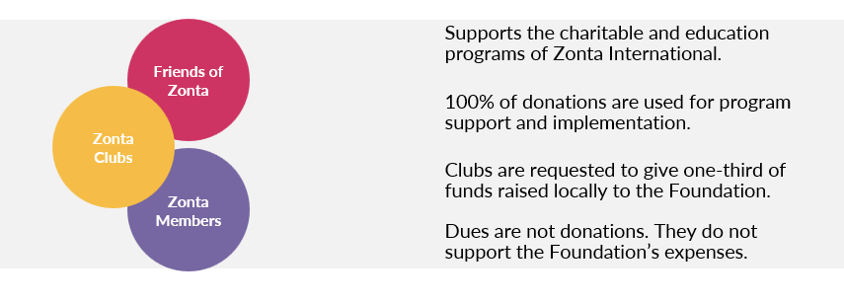
Zonta Foundation for Women Funding
Notes:
Opening / Impact
Through your generosity, the Zonta Foundation for Women continues to make a significant impact in improving the lives of women and girls around the world.
To sustain and grow this impact, we must maintain a financially strong and stable Foundation.
Where Foundation Revenue Comes From
Our revenue is powered by donations from Zonta clubs, members, and friends of Zonta.
Clubs are encouraged to donate at least one‑third (1/3) of the funds they raise locally to the Foundation.
The remaining two‑thirds (2/3) may be kept for their local service projects.
Acknowledgment & Encouragement
Please extend heartfelt thanks to clubs for their support in the last biennium.
Their contributions are essential to reaching this biennium’s funding goals.
Last biennium, 82% of clubs made a gift—let’s aim for 100% participation this biennium!
How Donations Are Used
Every donation makes a difference: 100% of contributions go directly to program support.
For this biennium, the Foundation is not receiving operating support from Zonta International.
Operating expenses will instead be covered through the Foundation’s investment income.
Important Reminders
Dues are not donations.
Only voluntary contributions count toward Foundation giving.
Only donations made by active Zonta clubs and members, along with solicited corporate gifts, are included in district totals.

Slide 25
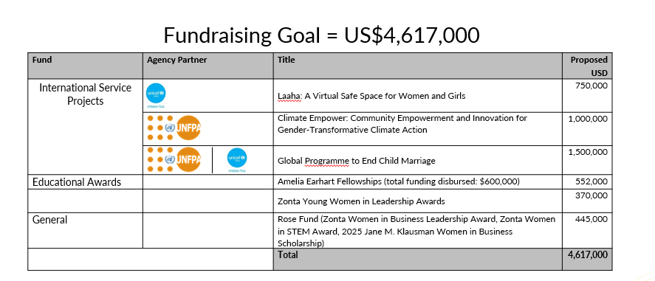
2024-2026 Fundraising Goal
Notes:
🌍 Project Selection – Brief Overview
UN agencies and reputable NGOs submit project proposals to the president‑elect.
Proposals may be new or recommended for a second biennium.
President‑elect reviews and consults with partners, then submits selections to the Foundation Finance Committee.
After Finance Committee approval, projects move to the ZI and Foundation Boards.
Final approval is done by the Convention body through a vote.
Donations fund the biennium’s projects; reserves cover any shortfall.
Zonta commits only what is already in reserves, ensuring fiscal responsibility.
💛 Gift Funds – Quick Summary
Educational Awards
Amelia Earhart Fellowship Fund – Supports AE Fellowships for women in aerospace and space sciences.
Young Women in Public Affairs Fund – Supports awards for young women (16–19) showing leadership in public policy and service.
International Service Projects
Laaha: A Virtual Safe Space for Women and Girls
Climate Empoewr: Community Empowerment and Innovation for Gender-Transformative Climate Action
Global Program to End Child Marriage
Rose Fund
Supplements programs not fully funded and supports new initiatives (e.g., Women in Business Leadership Awards, STEM Awards).
Endowment Funds – Not shown here:
Endowment Fund – Long‑term income source; principal never spent.
AE Fellowship Endowment – Sustains AE Fellowships long term; this biennium contributes US$48,000 in earnings.
🔍 Important Note
Donations to program and project funds count toward the biennial fundraising goal.
Donations to Endowment Funds do not, as they are invested for future impact.

Slide 26
International Service Projects Overview
Notes:
I want to provide a brief overview of each of the international service projects and their impact.

Slide 27
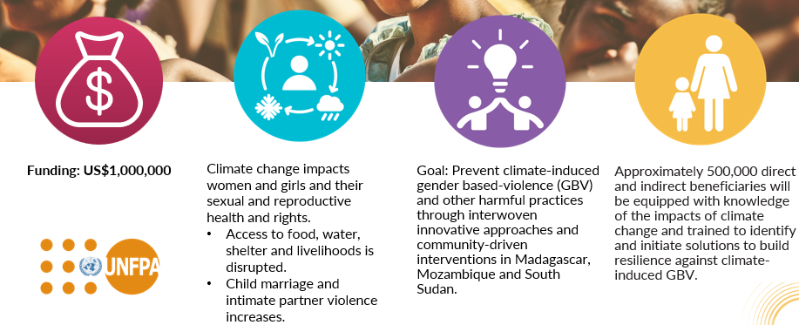
Climate Empower: Community Empowerment and Innovation for Gender Transformative Climate Action
Notes:
What & Where
New project to prevent climate‑induced GBV and harmful practices
Focus countries: Madagascar, Mozambique, South Sudan (high climate vulnerability)
Why It Matters
Rising temperatures intensify poverty, inequality, and extreme events (cyclones, flash floods, drought, extreme heat)
Disrupted livelihoods and services lead to conflict and heightened risks for women and girls
Core Challenge
Climate stressors intersect with deeply rooted discriminatory norms
These norms justify/tolerate violence and limit access to education, healthcare, and economic opportunity—especially in rural areas
Our Approach
Prevention first: address drivers of GBV linked to climate shocks
Community resilience: strengthen systems and services disrupted by disasters
Norms change: engage leaders and communities to shift harmful social norms
Women & Girls as Leaders
Elevate women and girls as decision‑makers in local climate action
Integrate their perspectives to design gender‑responsive, lasting solutions
Tailor protection strategies to the intersection of climate risk and GBV
Expected Results
Reduced GBV risks during and after climate events
Improved access to services (education, health, protection)
Resilient communities with inclusive early‑warning, preparedness, and recovery plans
Sustained norms change supporting safety and autonomy
How Clubs Can Help
Donate to this biennium’s international service portfolio
Advocate & educate: share the climate‑GBV link locally
Partner with local groups on resilience and protection activities

Slide 28
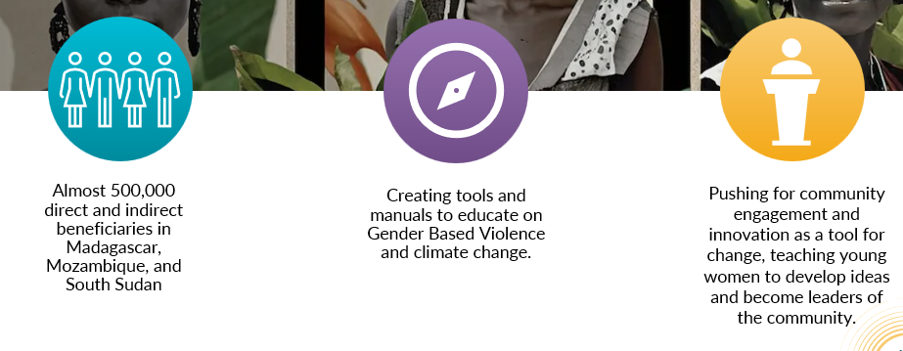
Climate Empower: Results
Notes:
Climate Empower operates in Madagascar, Mozambique, and Sudan, three of the world’s most climate‑vulnerable countries.
Nearly 500,000 people are benefiting from the project, including 150,000 direct beneficiaries, primarily young women and girls.
The program recognizes that gender‑based violence increases during climate stress, as extreme weather worsens risks like intimate partner violence.
To address this, Climate Empower created tools and manuals to help communities understand the link between climate change and GBV and develop local solutions.
Droughts and floods increase economic pressure, sometimes leading families to marry daughters early in exchange for bride price.
The program responds through youth‑focused innovation hubs, especially for girls and young women, and uses return‑to‑school policies after childbirth as advocacy tools—particularly in Madagascar.
A central focus is helping women and girls develop their own climate‑resilient ideas and become leaders within their communities.
By challenging harmful norms and transforming gender roles, Climate Empower strengthens community resilience, reduces GBV, and promotes inclusive climate action.
Overall, the project champions women‑ and girl‑led innovation to build safer, more resilient communities in the face of climate change.

Slide 29
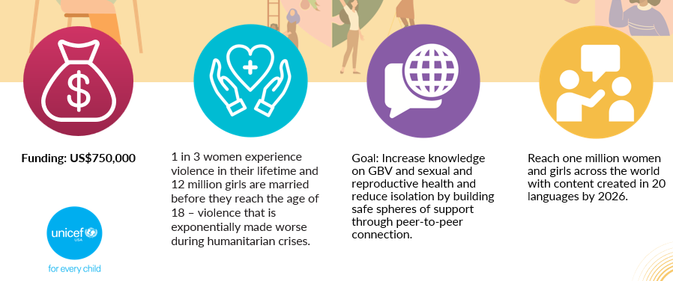
LAAHA: A Virtual Safe Space for Women and Girls
Notes:
“Today, I want to introduce you to Laaha: A Virtual Safe Space for Women and Girls—one of the newest projects approved by delegates at the 2024 Convention.
Laaha is the first-ever digital, web‑based platform created by UNICEF specifically for women and girls living in crisis‑affected regions. It was designed to reach those who cannot safely or easily access physical safe spaces because of insecurity, distance, restrictive norms, or conflict.
Laaha has two main goals. It was co-created with over 500 of girls through workshops and feedback sessions.
First, it provides accurate, trustworthy information on gender‑based violence, sexual and reproductive health, menstrual health, healthy relationships, safety, rights, financial literacy, and local services for those experiencing violence. Over time, it will mirror the sense of community and support that physical safe spaces provide.
Second, Laaha reduces isolation by creating peer‑to‑peer connection. A moderated forum allows adolescent girls to support one another and build safe social networks.
This project is especially important because the pandemic showed us how quickly the digital world is growing—yet many platforms weren’t built with the needs of women and girls in mind. Laaha fills that gap by offering a safe, culturally appropriate, accessible digital environment, including for girls with disabilities and married girls who often face the greatest barriers.
Laaha is available in more than 20 countries and over 15 languages. The plan is to increase to 20 languages by 2026.
Ultimately, the goal of Laaha is simple but powerful: to ensure women and girls—especially those at the highest risk—can access the information, support, and services they need to stay safe, stay informed, and stay connected.
How the Laaha Program Works (Concise Version)
Laaha was designed with direct input from women and girls, ensuring the platform reflects their needs and addresses the gender digital divide.
Users can access trusted information on menstrual health, healthy relationships, safety, rights, financial literacy, female anatomy, and services for those experiencing violence.
Content is delivered through short articles, podcasts, and videos, making it accessible regardless of literacy level.
An interactive chatbox connects users with trained GBV specialists, and a moderated forum offers safe peer‑to‑peer engagement through local counselors.
For safety, posting is disabled whenever moderators are offline, and Laaha collects no personal or identifying information.
All moderators follow a strict training framework, including a guide, training modules, and a code of conduct.
The platform is designed for accessibility with minimal text, strong visual content, and an always‑visible quick‑exit button that clears browsing history.

Slide 30
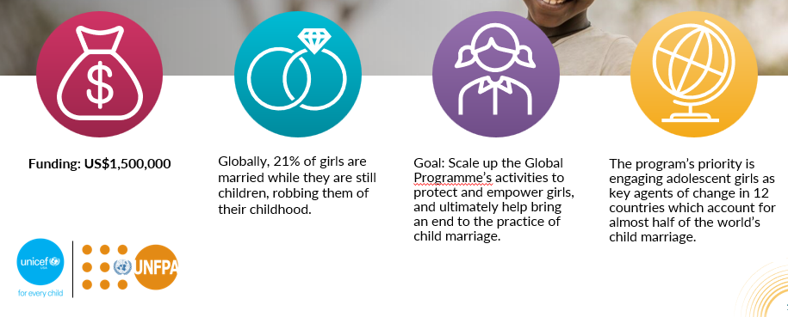
Ending Child Marriage: A Programe to Accelerate Global Action Phase III
Notes:
Overview
Launched during the 2018–2020 biennium in honor of Zonta’s centennial.
Inspired members to examine child marriage issues within their own countries.
The program now continues in Phase III (2024–2026).
Phase III (Current Biennium: 2024–2026)
Focus remains on adolescent girls as agents of change.
Implemented in 12 high‑prevalence countries: Bangladesh, Burkina Faso, Ethiopia, Ghana, India, Mozambique, Nepal, Niger, Sierra Leone, Uganda, Yemen, and Zambia.
Priorities for this phase:
Strengthening government leadership and ownership of the work.
Building evidence and data to sustain long‑term change.
Responds to global challenges—“polycrisis” conditions and pushback on gender equality—while accelerating progress toward ending child marriage by 2030.
Phase II (2020–2024) – Key Achievements
Increased political commitment and gender‑responsive policies.
Expanded support for unmarried and married adolescent girls.
6.3 million girls received life skills and comprehensive sexuality education through safe spaces.
Phase I (2016–2019) – Key Achievements
Nearly 8 million girls reached with life skills and school support.
39 million community members engaged in behavior‑change initiatives.
26,000 schools strengthened their girl‑friendly environments.
Core Objectives
1. Elevate Girls’ Voice & Agency
Build skills and knowledge for marginalized adolescent girls.
Promote gender equality within families and communities.
2. Increase Resources & Opportunities
Strengthen education, health, and child protection systems.
Address poverty, a key driver of child marriage.
3. Strengthen Legal & Political Action
Support governments in strengthening and implementing national plans to end child marriage.
Build government capacity for data‑driven, evidence‑based decisions.

Slide 31
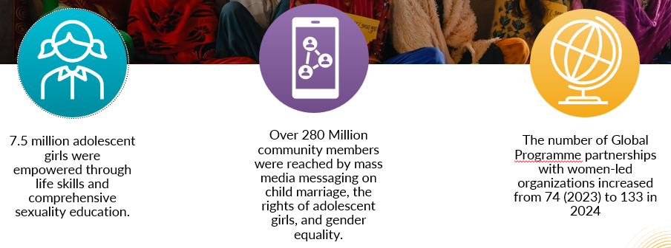
Global Programme To End Child Marriage – Results to Date

Slide 32
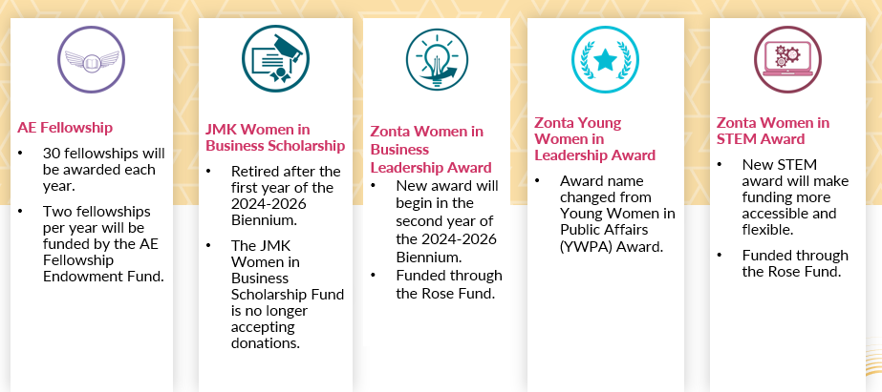
Education Programs

Slide 33
Education Programs
Amelia Earhart Fellowship – 2024-2026 total funding: $60,000 –
60 fellowships of $10,000 each to women pursuing Ph.D./doctoral
degrees in aerospace engineering and space sciences.
Zonta Women in Business Leadership Award – 2024 – 2026 total funding: $100,000 – 10 international awards of $10,000 each.
Zonta Women in Leadership Award – 2024- 2026 total funding: $370,000 – 37 international awards of $5,000 each
Zonta Women in STEM Award – 2024- 2026 total funding: $160,000 – One award cycle of 16 awards of $10,000 each celebrating the remarkable accomplishments of women between 18-35 years of age in STEM fields.
Notes:
✈️ Amelia Earhart Fellowship
One of Zonta’s longest‑running programs, established in 1938.
Supports women pursuing advanced studies in aerospace engineering and space sciences.
Since inception: 1,764 Fellowships, totaling US$11.9 million, awarded to 1,335 women from 79 countries.
Example Fellow: 2023 Fellow Niyati Desai, a PhD student designing coronagraph instruments for imaging exoplanets at Caltech.
💼 Zonta Women in Business Leadership Award
Recognizes women ages 18–35 making significant impact in the business world.
Honors leadership, innovation, ethics, and contributions addressing issues affecting women, girls, or climate justice.
Operates at club, district, and international levels; larger districts may submit two candidates.
10 awardees selected by an independent jury.
Each award: US$10,000 plus a one‑year supporting membership in Zonta International.
Funded through the Zonta Foundation for Women Rose Fund.
🌱 Zonta Young Women in Leadership Award
(Formerly Young Women in Public Affairs – YWPA)
Honors young women ages 16–19 for leadership, volunteer service, and commitment to empowering women worldwide.
Established in 1990.
Zonta has granted 1,128 awards, totaling US$1,673,750, to 956 young women from 61 countries.
🔬 Zonta Women in STEM Award (New for 2024–2026)
Replaces earlier STEM/Technology pilot programs to improve access and participation.
Supports women ages 18–35 making outstanding contributions in science, technology, engineering, and mathematics.
Recognizes research, innovation, and advancement in STEM.
Operates at club, district, and international levels; districts with 1,200+ members may submit two applications.
16 awardees selected by an independent jury.
Aims to address persistent underrepresentation of women in STEM and inspire future generations.

Slide 34
Scorecard – HOW ARE WE DOING?

Slide 35
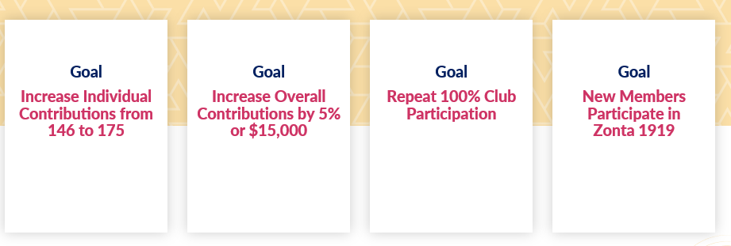


District 10 Fundraising Goals
Notes:
This district is such a giving district and I thank you for your support of both the foundation as well as the endowment.
We have established goals this year.
Goal 1 – Increase the number of individuals giving.
Goal 2 – Increase the overall generous giving by $15,000.
Goal 3 – Continue having the support of all clubs.
Goal 4 – Have members participate in Zonta 1919

Slide 36
Update of District 10 Giving for the Biennium
Notes:
District 10 –
Number 2 – In overall giving – We are 13% ahead of giving from previous biennium for the Foundation
Number 4 in Individual Giving – 27% of District 10 Gives
Number 4 in Overall Giving - Foundation and Endowment

Slide 37

Club Ranking
Central Oklahoma – New Number 1
Dallas
Houston – Moved Up
Lafayette
West Hildago
Greater East Texas
Parker County
Fredericksburg – Moved Up 6 Postions
Fort Smith – Moved Up
Brownsville
Seguin
E-Club of USA 2
Johnson County
Austin
Mineral Wells
Shreveport
Longview
San Antonio/Alamo City

Slide 38
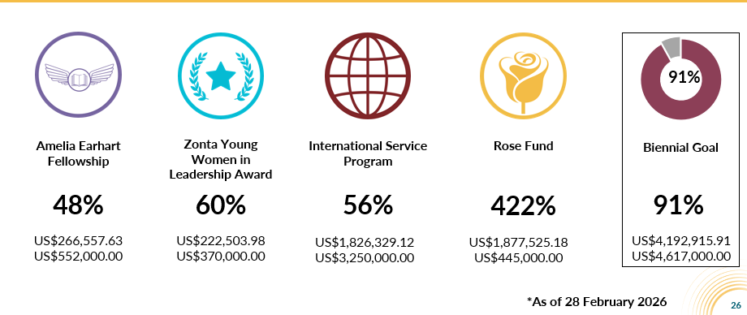
Zonta Foundation for Women 2024-2026 Giving Totals*
Notes:
We have a little ways to go and we can definitely close the gap!
Give yourself a round of applause!

Slide 39
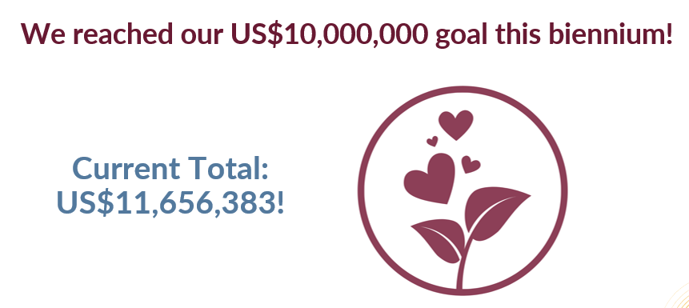
General Endowment Fund
Notes:
Another celebratory milestone of reaching $10MM

Slide 40
Table Discussion
What have you learned new about the Zonta Foundation after today’s presentation?
What inspires you most about Zonta?

Slide 41
THANK YOU FOR YOUR SUPPORT OF THE ZONTA FOUNDATION FOR WOMEN!!

Slide 42
Live Auction
A Few Words About District 10 and Our Live Auction
In District 10, our live auction is all about
fun, energy, and friendly competition.
Rule 1: Have fun!
Rule 2: Bid—and bid often! But please never feel pressured to give.
Rule 3: Don’t be surprised if a bottle of wine sells for over $100—District 10 members can be spirited bidders! Outbidding a fellow Zontian is all in good fun and always brings plenty of laughter.
The purpose of the auction is simple: raise money and enjoy ourselves.
Cheer on your fellow Zontians—especially when a bidding war breaks out!

Slide 43
